Slide 1
Time Series Forecasting of Weekly Stock Prices
Tracie Le
Md Farhan Chowdhury
Pallav Singh
Areeb Irfan
Mohammad Rahim

Slide 2
PROJECT OBJECTIVE
Forecast weekly closing prices of selected NASDAQ-listed stocks
Generating short-term forecasts for multiple companies
Comparing model predictions with human forecasts
Evaluating forecasting performance once future prices become available
Because the forecast period occurs in the future, the actual prices are not yet known.

Slide 3







Companies Included
1. Adobe
ADBE
7. Tesla
2. Apple
TSLA
AAPL
8. United Airlines
3. NVIDIA
UAL
NVIDIA
9. Warner Music
4. Amazon
AMZN
WMG
5. AstraZeneca
10. Wendy's
AZN
WEN
6. Starbucks
11. American Airlines
SBUX
AAL

Slide 4
Time-series Forecasting Model
Used Auto-ARIMA.
Components:
AR (Autoregressive): uses past values
I (Integrated): differencing to remove trends
MA (Moving Average): accounts for past forecast errors
It automatically chooses the best (p,d,q) combination
The model also integrates external variables (exogenous variables):
NASDAQ index
S&P 500 index
These variables helped incorporate overall market conditions into the forecasts.

Slide 5
Forecasting Process
Steps:
Collected 5-year stock data using yfinance
Converted daily prices → weekly (Friday close)
Added market indices as external factors (NASDAQ Composite & S&P 500)
Applied 80% train / 20% test split
Used Auto ARIMA (ARIMAX) to select optimal (p,d,q)
Evaluated using MAE and MSE
Refit model on full dataset
Forecasted next 5 weeks
The process allows us to generate predictions for the next five weeks based on historical patterns, market conditions, and relationships with broader indices.

Slide 6
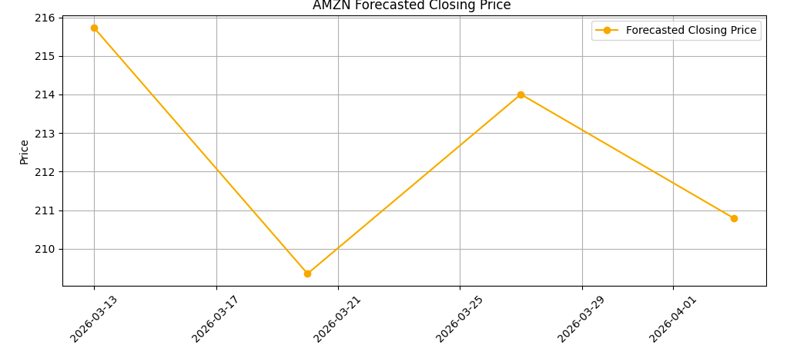
Example Forecast Graph (AMZN)

Slide 7
Human Forecasting Model
Used XGBoost decision tree model for forecasting.
Components:
• XGBoost Algorithm
• Market Variables
These features allowed the model to capture short-term momentum and historical price trends.
Technical Indicators:
Open price
Close price
High / Low prices
Trading volume
Minimum price
Moving Average Indicators:
Last 5 days
Last 10 days
Last 15 days
Last 30 days
Last 50 days
Last 90 days

Slide 8
Forecasting Process
Steps:
Incorporated external market shocks to improve realism in the predictions.
Divided stocks in three risk categories
Used oil price shocks to simulate the impact of sudden changes in energy markets.
Included regional instability factors to account for geopolitical events affecting stock prices.
Introduced randomization layers to simulate uncertainty and market volatility.
These adjustments helped the model better reflect real-world volatility.

Slide 9
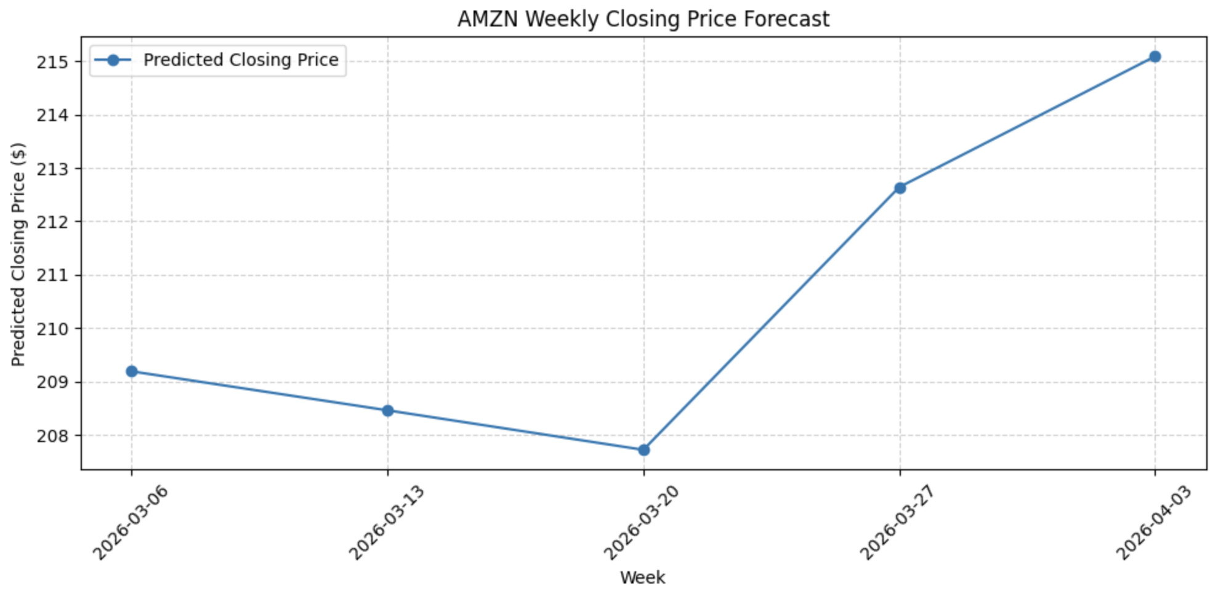
Example Forecast Graph (AMZN)

Slide 10
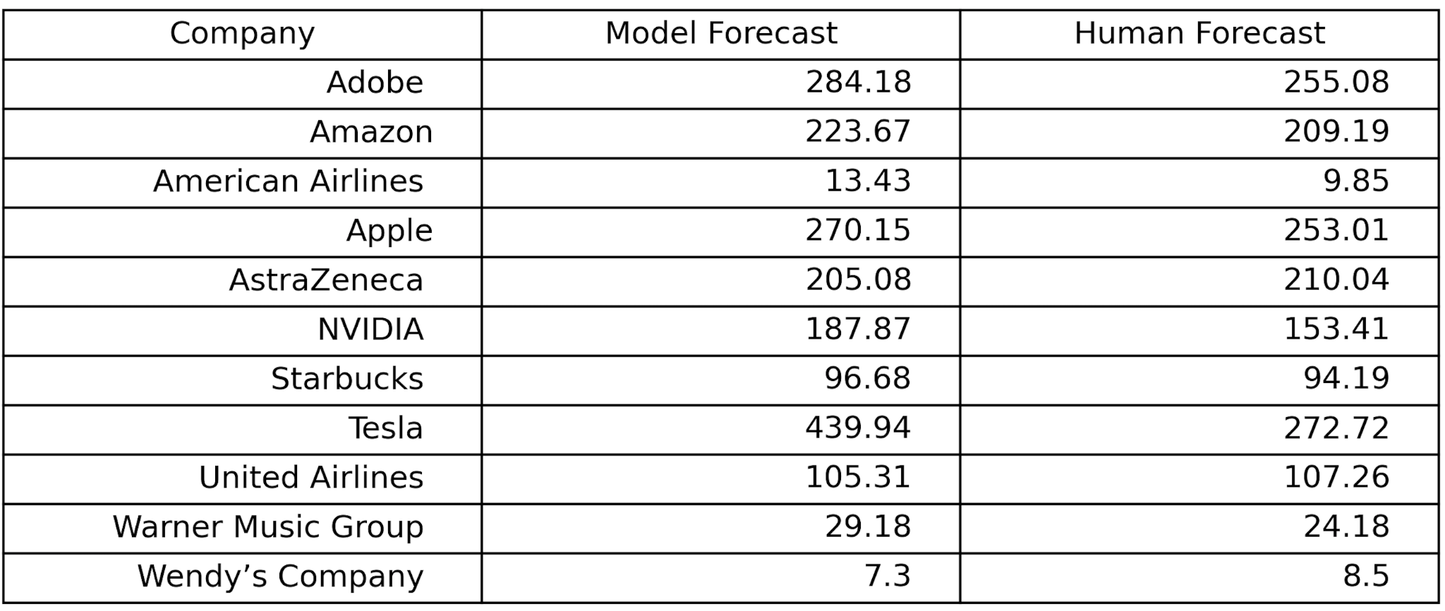
Example Forecast Results

Slide 11
Key Insights
From the predictions and backtesting results:
Statistical models provide consistent, data-driven predictions
Forecast accuracy varies depending on stock volatility
Market-wide factors influence many stocks simultaneously
Including market indices can improve model performance
Overall, time series models provide a structured approach to forecasting financial data.

Slide 12
Conclusion
This project developed a time series forecasting model for stock prices using ARIMA.
Key contributions:
Generated forecasts for multiple companies
Incorporated market index indicators
Compared model forecasts with human predictions
Once future prices become available, the model’s forecasting accuracy will be evaluated.

Slide 13
Final Takeaway
Forecasting financial markets is challenging due to volatility and uncertainty.
However, statistical time series models provide a systematic and data-driven approach for analyzing and predicting market behavior.

Slide 14
THANK YOU!
ANY QUESTIONS?

